Slide 1
StuDocu Assignment
Presented by:
Pooja Singh.

Slide 2
Table of contents:
Technical solution selection
Framework used
Test design approach
Instructions for running

Slide 3
Technical solution selection
The page has headings, text fields and different buttons for adding questions, sorting them and removing them
As the page is very simple and needs fewer validation, I have covered the same in my scenarios
Keeping the market and framework used in recent times, I would be going to BDD framework, which is easily understandable by any Layman user too
I have used Git as version control tool for pushing my code into the required Git hub
For project management I am using Maven tool which would help me with adding dependencies and managing the project easily suing the Maven cycles like clean, install, run etc
I am using Selenium with Java for automation based on my previous experience

Slide 4
Framework used
The framework used here is BDD framework, it has different files like feature files, step definition files, runner files etc. All these are defined in the specific packages
Exceptions package has exception handling mechanism file for eg: NotFoundElement.java
Methods package has SeleniumHelper.java which has all methods related to selenium, js and actions which can be called anywhere in framework
The WebConnetor package has Webconnector.java for writing Driver invoking, setup and closing it
The applicationPages has our pages in which the locator and Selenium code is written. for eg: Assignmentpage.java
constantVariables package has Constant.java file which has constants related to framework
The runner package has our runner file in which cucumber options is used for file calling. For eg: AssignmentPageRunner.java
The stepdefs package has the stepdefinition files where the steps invoking for each statement written in feature file is captured. For eg: AssignmentPageSteps.java
JRE system library and Referenced Libraries has all the library files

Slide 5
Framework used Cont…
Maven dependencies has all the .jar dependencies from POM. xml file
src/test/resources has features folder in which folder for each feature is written under which we have feature files. For eg: Validation_AssignmentPage.feature
src>test has config folder which has application.properties file, library has our driver for eg: chromedriver.exe and testdata folders has our test data sheet for eg: Data.xlsx
The reports are generated in our target folder> cucumber-reports for in a folder way for each page. for eg: AssignmentPage. The reports are made simpler and kept even in test-output folder. These can be used for sharing it to the team
Since using Maven, POM.xml has all dependencies and other configuration required for the framework
testng.xml is used for setting up testng tags and runner the files sequentially
Assert and SoftAssert classes are used for addition the validation in the script

Slide 6
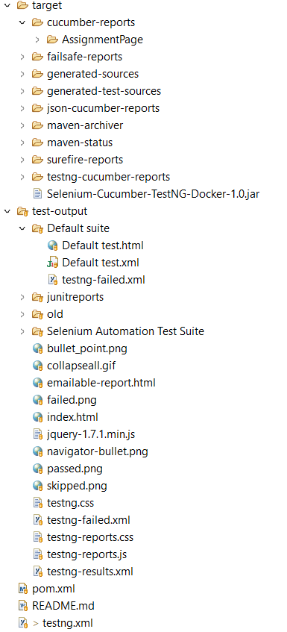
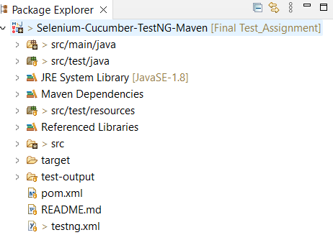
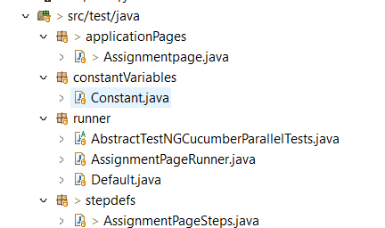
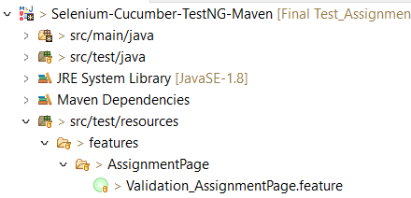
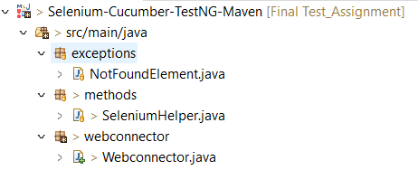
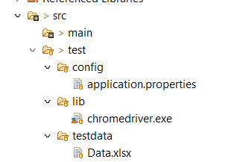
Framework Snippets

Slide 7
Test design approach
The different things tested in the automation are:
Feature: Assignment Page Verifications
Background: Validation of Assignment Page webElements displayed
User validates different UI fields present in the page
Scenario: Validation of create question button functionality
User enter the details
Validates all the questions additions in the UI
User clicks on Sort questions button
User validates the sorted questions result
User clicks on Remove questions button
User validates the Remove questions result

Slide 8
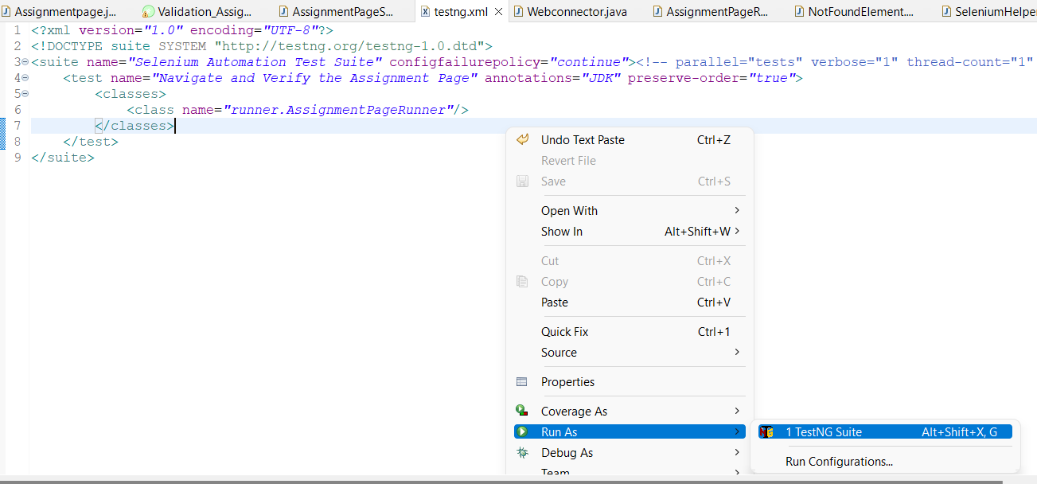
Instructions for running
The test can be run in 2 ways:
Using testing.xml file
Open the testing.xml file> Right click and click on run as> TestNG suite

Slide 9
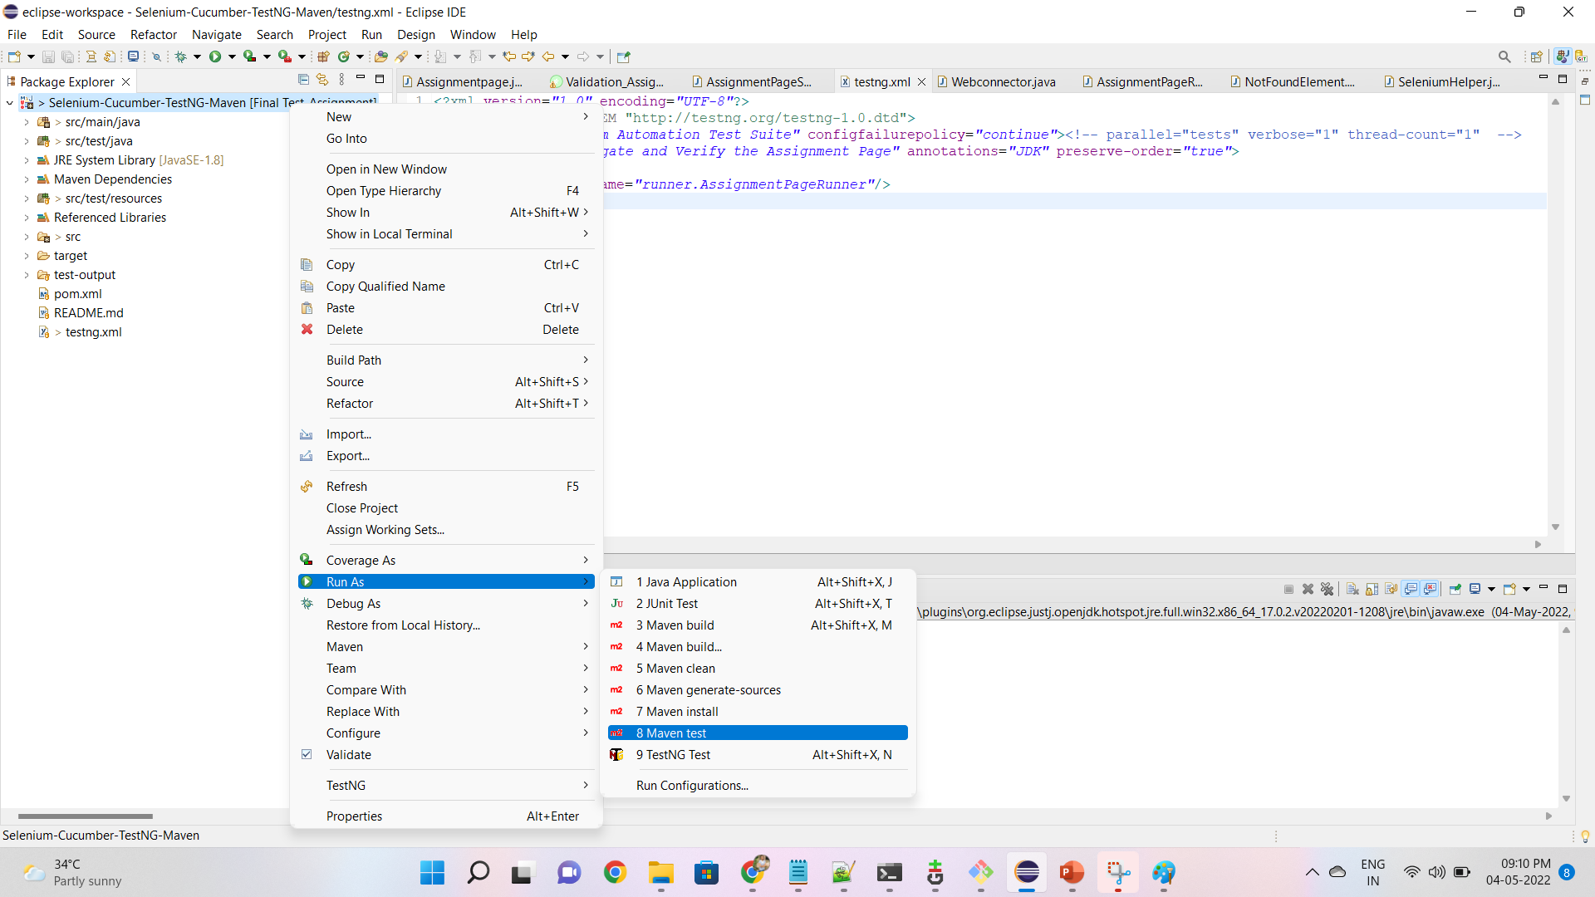
Instructions for running Cont…
The test can be run in 2nd way as:
Using run as > Maven test option from project

Slide 10
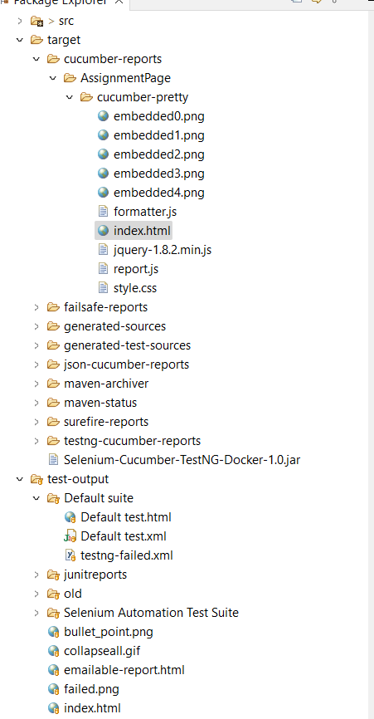
Reporting pages
The reports are generated in following folders as:

Slide 11
Thank You!!

